Slide 1


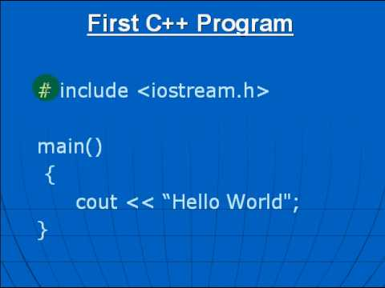
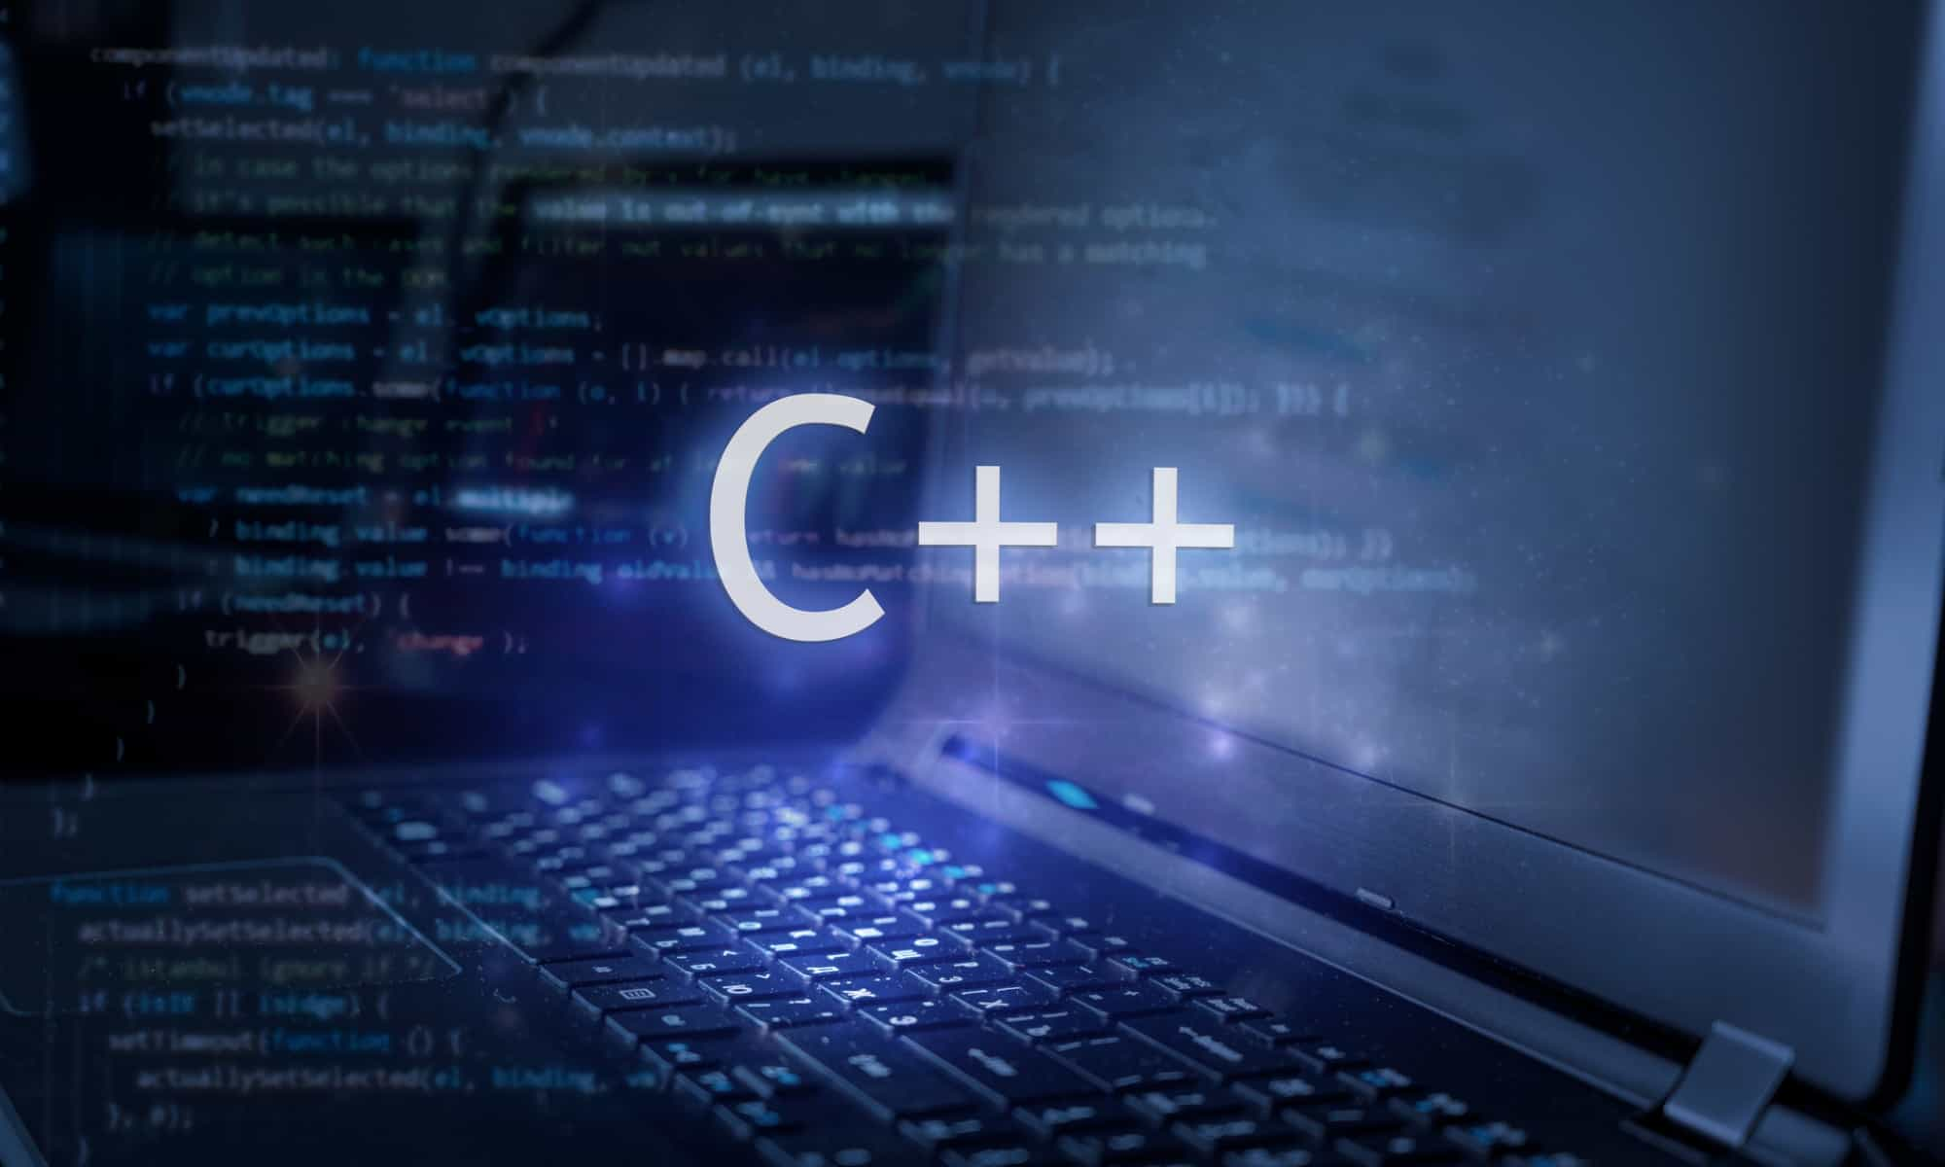
Al-Azhar University
Faculty of Engineering
Systems and Computer Engineering Dept.
Intelligent Systems Engineering Program
ENG 151
Computer Programming I
Prof. Ahmed Youssef

Slide 2

Al-Azhar University
Faculty of Engineering
Systems and Computer Engineering Dept.
Intelligent Systems Engineering Program
ENG 151
Computer Programming I
Functions

Slide 3
Function
A function is a block of code which only runs when it is called.
Advantages of Function
Reusability
Modularity
Efficiency
Readability
Notes:
Reusability: Functions can be reused throughout a program, which can save time and effort. For example, if you need to perform a calculation multiple times, you can write a function to perform the calculation and then call the function each time you need to perform the calculation.
Modularity: Functions make code more modular, which means that the code is divided into smaller, more manageable pieces. This makes the code easier to read, understand, and maintain.
Efficiency: Functions can help to write more efficient code. For example, if you have a function that performs a complex calculation, you can call the function instead of rewriting the calculation each time you need to perform it.
Readability: Functions can make code more readable and easier to understand. For example, instead of writing a long block of code to perform a specific task, you can write a function to perform the task and then call the function in your code. This makes the code more concise and easier to read.

Slide 4
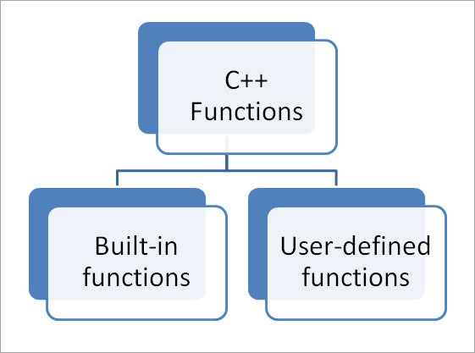
Types of Functions
pow(a, b)
min(a, b)
max(a, b)
sqrt(a)
rand()
Notes:
<pow(2,5)

Slide 5
Predefined (Built-in) Functions
Some of the predefined mathematical functions are:
sqrt(x)
pow(x,y)
sin(x)
Predefined functions are organized into separate libraries
I/O functions are in iostream header
Math functions are in cmath header

Slide 6
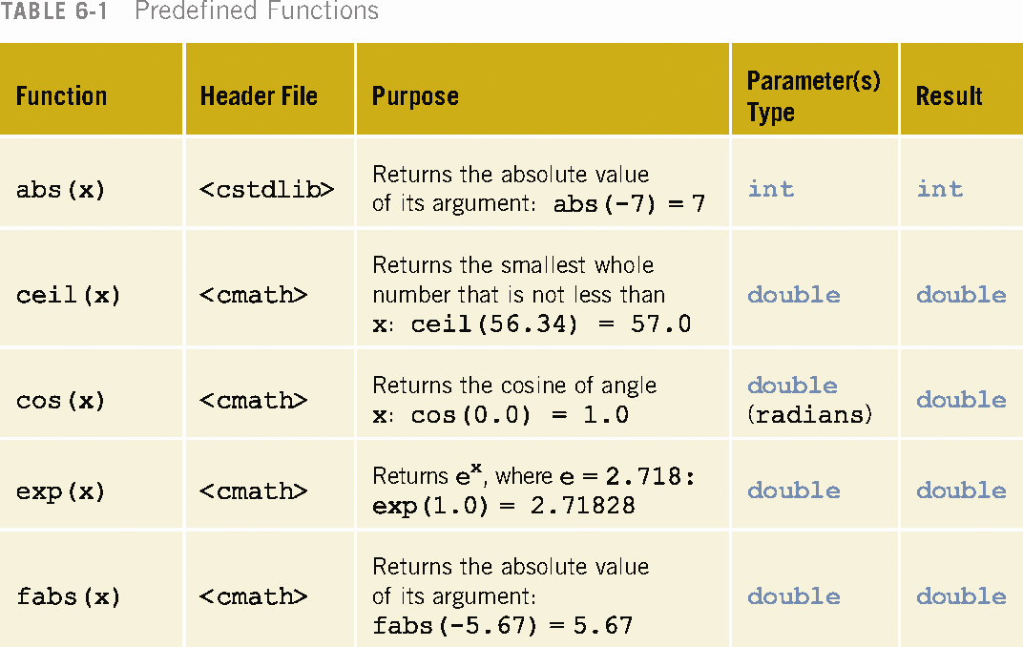

Slide 7
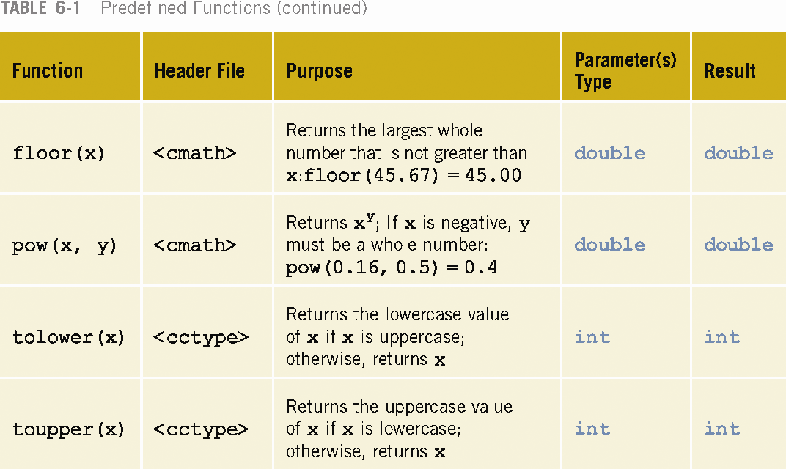

Slide 8
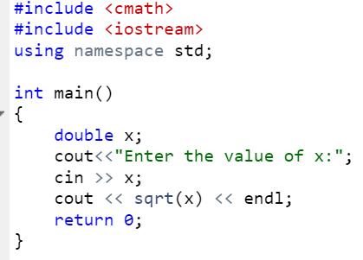
sqrt( ) Function

Slide 9
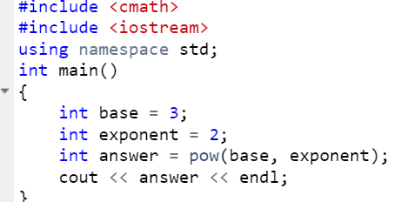
pow( ) Function

Slide 10
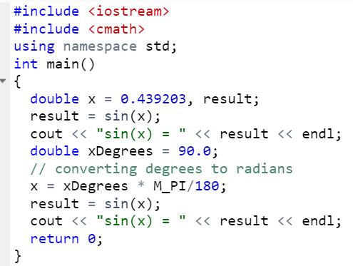
Notes:
#include <iostream>
#include <cmath>
using namespace std;
int main()
{
double x = 0.439203, result;
result = sin(x);
cout << "sin(x) = " << result << endl;
double xDegrees = 90.0;
// converting degrees to radians
x = xDegrees * M_PI/180;
result = sin(x);
cout << "sin(x) = " << result << endl;
return 0;
}

Slide 11
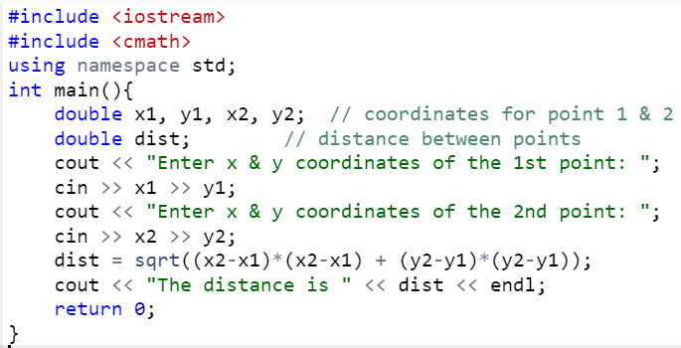
Distance between two points
Notes:
#include <iostream>
#include <cmath>
using namespace std;
int main(){
double x1, y1, x2, y2; // coordinates for point 1 & 2
double dist; // distance between points
cout << "Enter x & y coordinates of the 1st point: ";
cin >> x1 >> y1;
cout << "Enter x & y coordinates of the 2nd point: ";
cin >> x2 >> y2;
dist = sqrt((x2-x1)*(x2-x1) + (y2-y1)*(y2-y1));
cout << "The distance is " << dist << endl;
return 0;
}

Slide 12
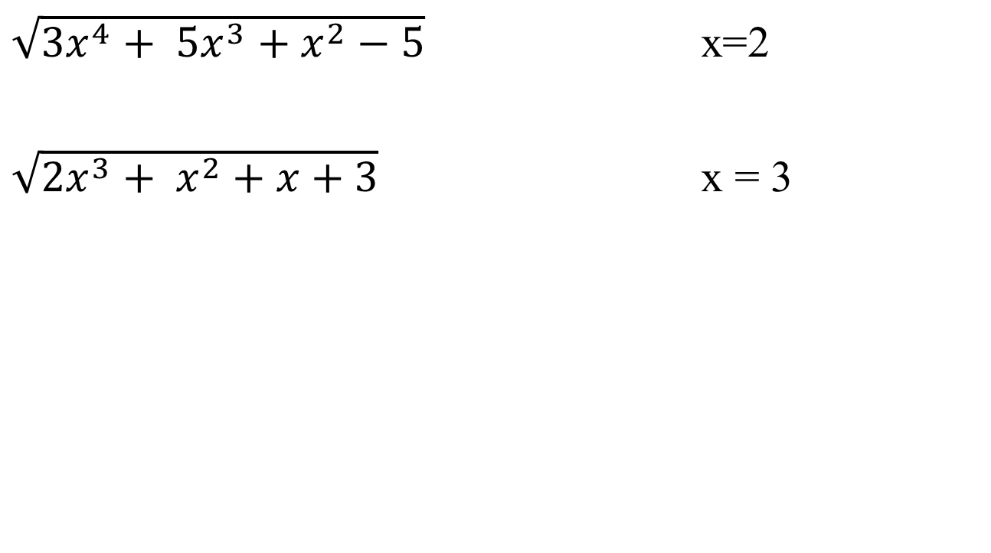
Exercise
$\sqrt{{3x}^{4}+ {5x}^{3}+x^{2}−5}$ x=2
$\sqrt{{2x}^{3}+ x^{2}+x+3}$ x = 3
Notes:
#include <iostream>
using namespace std;
int main()
{
int x=2;
int y = 3*pow(x,4) + 5*pow(x,3) + pow(x,2) -5;
double R = sqrt(y);
cout<<R;
return 0;
}

Slide 13
Standard C++ Character Functions
#include <iostream>
#include <ctype.h> // character type functions
using namespace std;
int main()
{
char ch;
cout << "Enter a character: ";
cin >> ch;
cout << "The toupper(" << ch << ") = "
<< (char) toupper(ch) << endl;
cout << "The tolower(" << ch << ") = "
<< (char) tolower(ch) << endl;
}
Notes:
Enter a character: n
The toupper(n) = 78
The tolower(n) = 110

Slide 14
User-Defined C++ Functions

Slide 15
Create a Function
void myFunction() { // code to be executed }
myFunction() is the name of the function
void means that the function does not have a return value.
inside the function (the body), add code that defines what the function should do
Notes:
C++ provides some pre-defined functions, such as main(), which is used to execute code. But you can also create your own functions to perform certain actions.
To create (often referred to as declare) a function, specify the name of the function, followed by parentheses ():

Slide 16
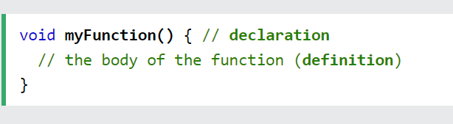
Function Declaration and Definition
A C++ function consist of two parts:
Declaration: the return type, the name of the function, and parameters (if any)
Definition: the body of the function (code to be executed)

Slide 17
Function to return the larger of two numbers.
double larger(double x, double y)
{
double max;
if(x >= y)
max = x;
else
max = y;
return max;
}

Slide 18
double larger(double x, double y)
{
if(x >= y)
return x;
else
return y;
}

Slide 19
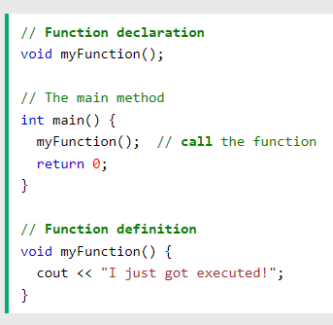
Function Declaration and Definition
You need to put Function declaration above main() if you write function definition below main().
Notes:
You will often see C++ programs that have function declaration above main(), and function definition below main(). This will make the code better organized and easier to read:

Slide 20
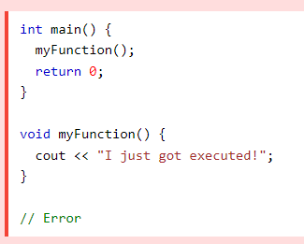
Note: If a user-defined function, such as myFunction() is declared after the main() function, an error will occur:

Slide 21
Function Prototype
Function heading without the body of the function.
Syntax: Function Prototype
functionType functionName(parameter list);
Note the semicolon at the end.
Example:
double larger(double x, double y);
double larger(double, double);

Slide 22
Parameters and Arguments
Parameter | Argument
A variable that is defined in the function definition. | A value that is passed to the function when it is called.
sum(int a, int b)
sum(10, 20)
Notes:
Information can be passed to functions as a parameter. Parameters act as variables inside the function.
Parameters are specified after the function name, inside the parentheses. You can add as many parameters as you want, just separate them with a comma:

Slide 23
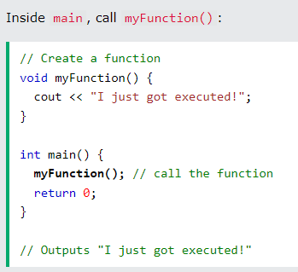
Call a Function

Slide 24
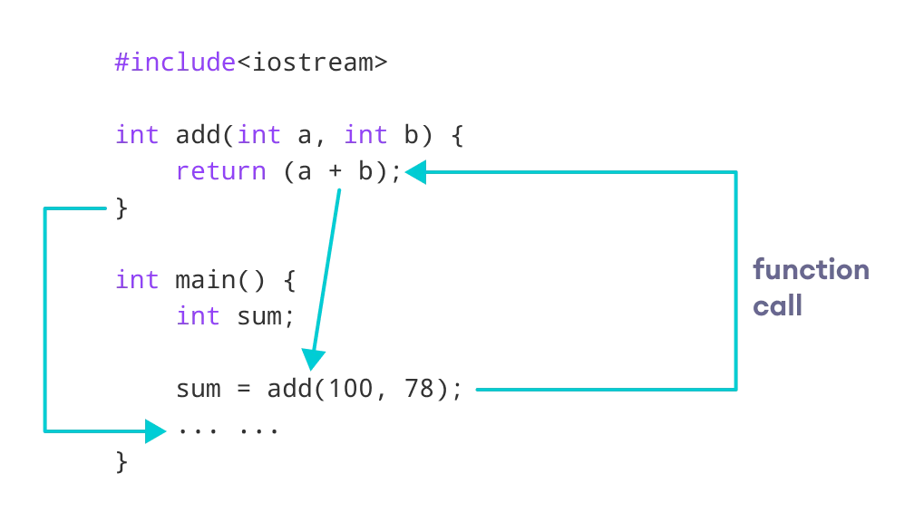
Call a Function

Slide 25
Example
// function returning the max between two numbers
int Max(int num1, int num2)
{
// local variable declaration
int result;
if (num1 > num2)
result = num1;
else
result = num2;
return result;
}

Slide 26
Example
Write a function to calculate the power in watts given the voltage and current.
Power = Voltage x Current
double calcPower(double V, double I)
{
return V * I;
}

Slide 27
Example
Write a function to calculate the resistance in ohms given the voltage and current.
V = I x R
double calcResistance(double V, double I)
{
return V/ I;
}

Slide 28
#include <iostream>
using namespace std;
float Average ( int X, int Y, int Z )
{
float AVG;
AVG = (X+Y+Z)/ 3.0;
return AVG;
}
int main(void)
{
int a,b,c;
float AVG;
a = 5;
b = 6;
c = 2;
AVG = Average (a, b, c);
cout<<"Average =" <<AVG;
}
Example Average.cpp
Function definition
Function call

Slide 29
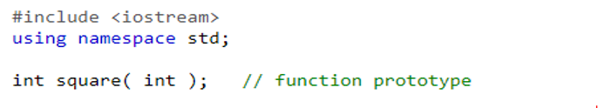
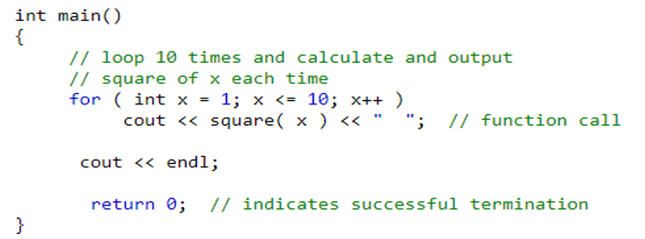
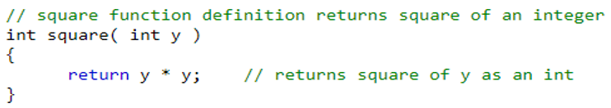
Square of first ten numbers

Slide 30
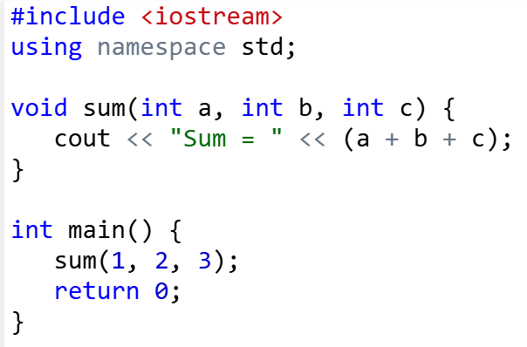
Multiple Function Parameters in C++

Slide 31
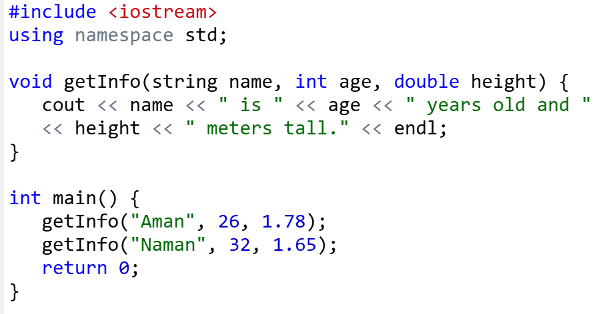
Multiple Function Parameters in C++

Slide 32
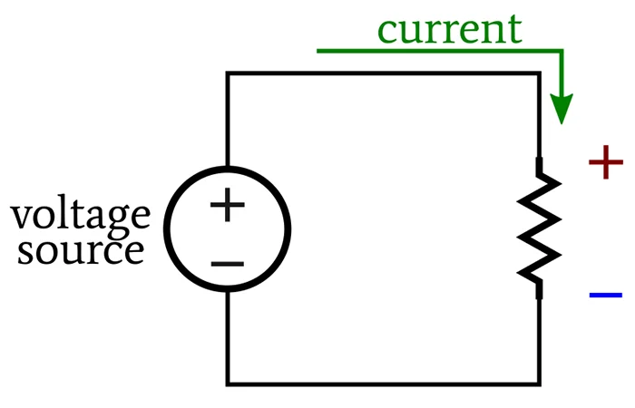
Example: Voltage drop
Write a C++ function that calculates the voltage drop across a resistor. The function should take the resistance in ohms and the current in amps as input and return the voltage drop in volts.

Slide 33
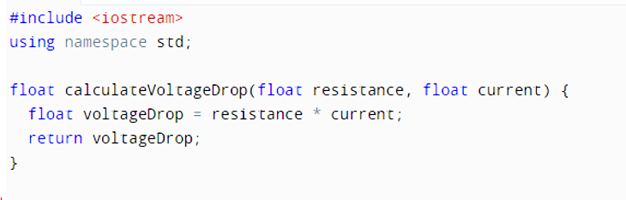

Slide 34
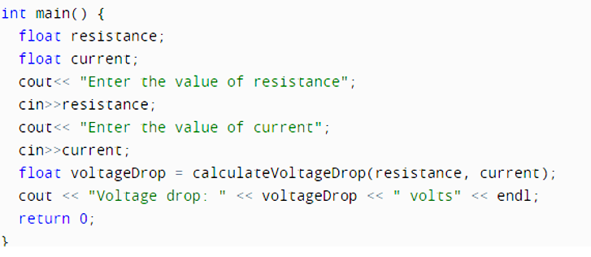

Slide 35
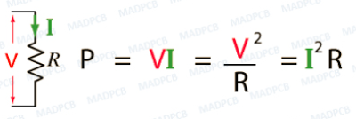
Example: Power dissipated in a resistor
Write a C++ function that calculates the power dissipated in a resistor. The function should take the resistance in ohms and the current in amps as input and return the power dissipated in watts.

Slide 36
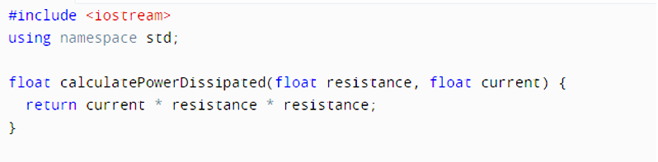
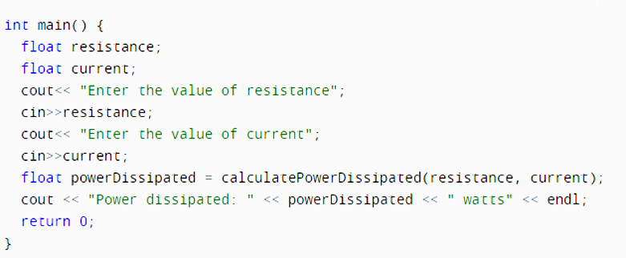

Slide 37
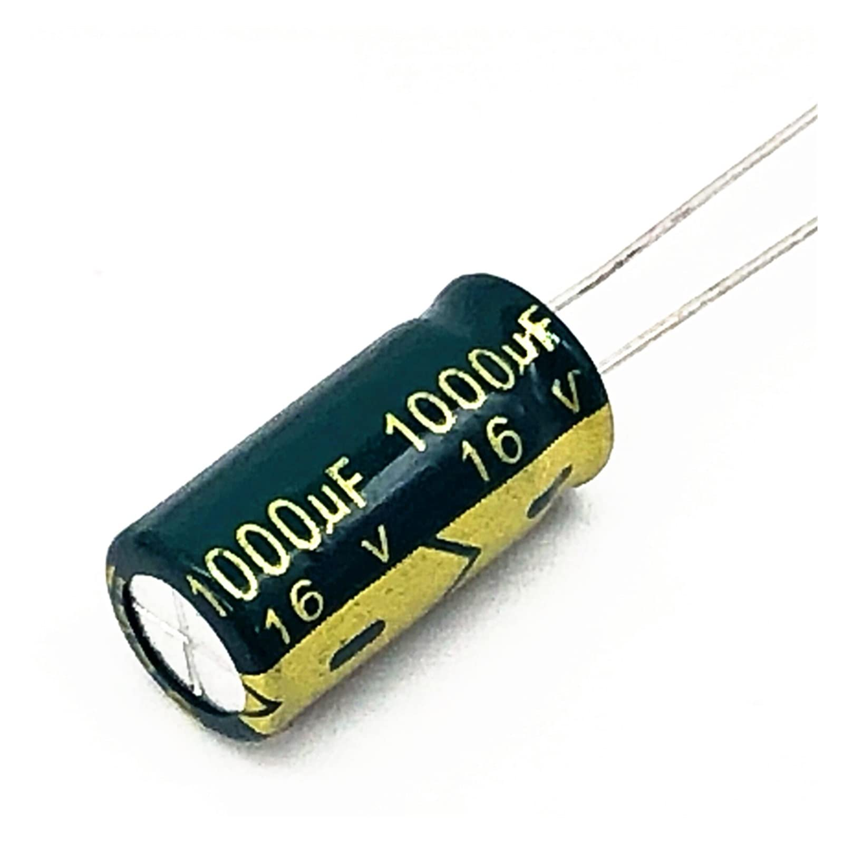
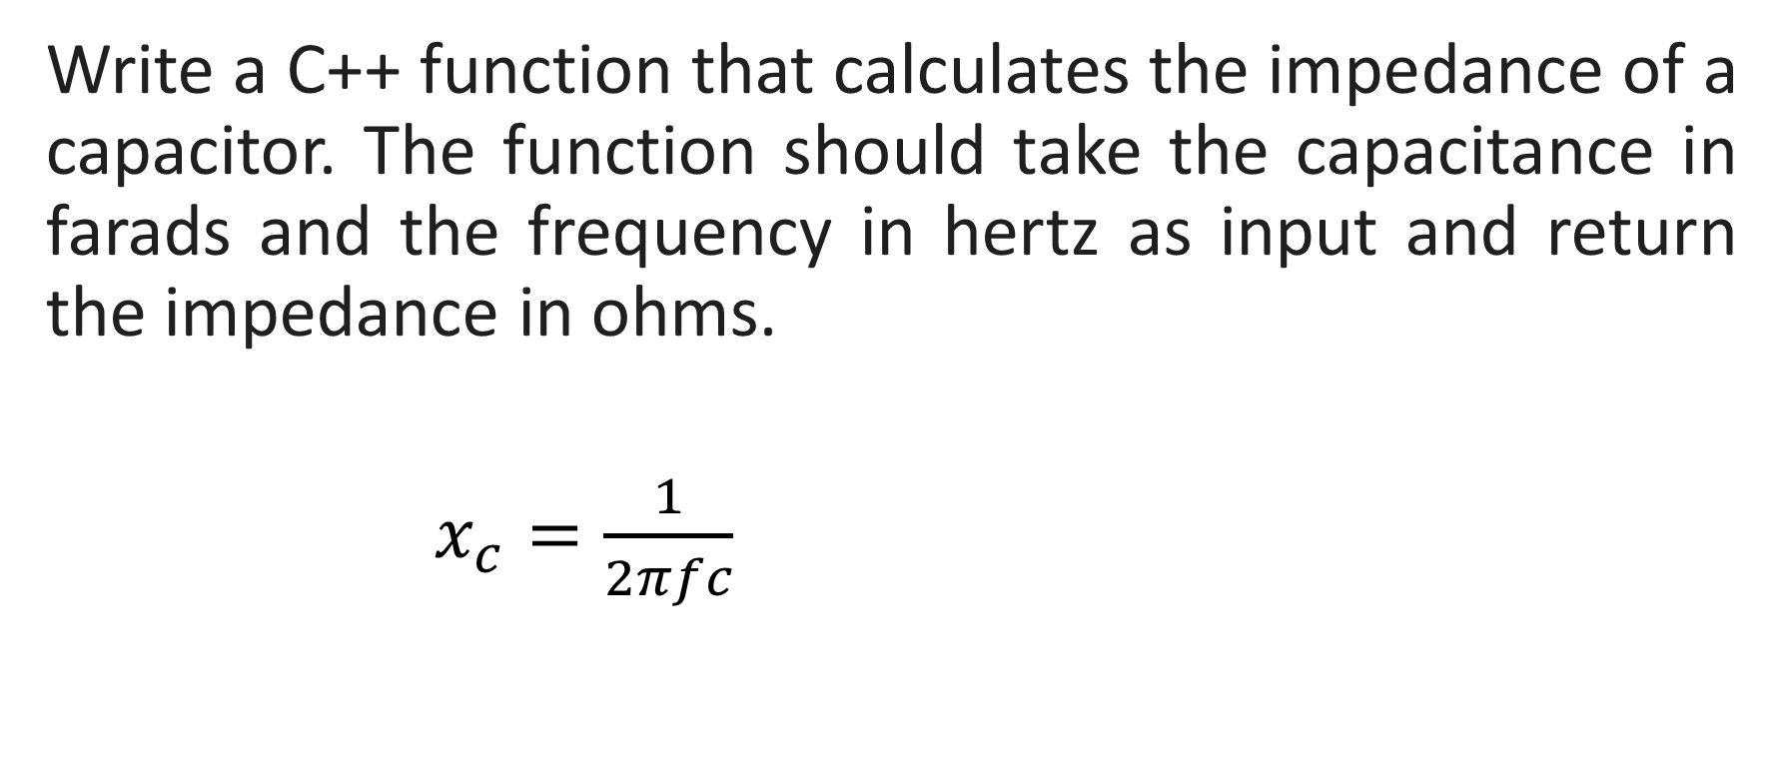
Example: Impedance of a capacitor
Write a C++ function that calculates the impedance of a capacitor. The function should take the capacitance in farads and the frequency in hertz as input and return the impedance in ohms.
$x_{c}=\frac{1}{2πfc}$

Slide 38
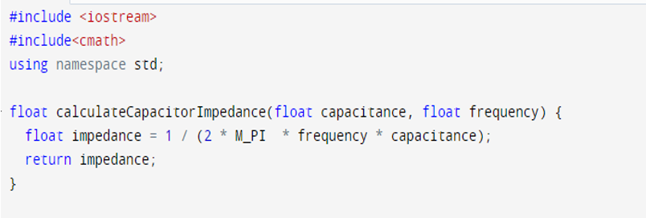
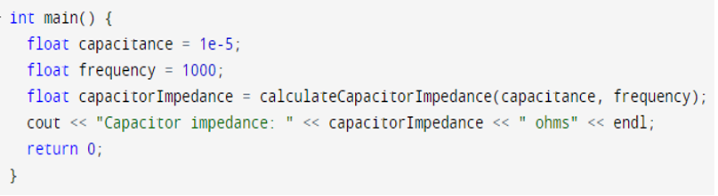
Notes:
#include <iostream>
using namespace std;
float calculateCapacitorImpedance(float capacitance, float frequency) {
float impedance = 1 / (2 * M_PI * frequency * capacitance);
return impedance;
}
int main() {
float capacitance = 1e-6;
float frequency = 1000;
float capacitorImpedance = calculateCapacitorImpedance(capacitance, frequency);
cout << "Capacitor impedance: " << capacitorImpedance << " ohms" << endl;
return 0;
}

Slide 39
#include <iostream>
using namespace std;
float CapacitorImpedance(float capacitance, float frequency) {
float impedance = 1 / (2 * M_PI * frequency * capacitance);
return impedance;
}
int main() {
float capacitance = 1e-6;
float frequency = 1000;
float cImpedance = CapacitorImpedance(capacitance, frequency);
cout << "Capacitor impedance: " << cImpedance << " ohms" << endl;
return 0;
}

Slide 40
Global / Local Variable
Inside a function or a block which is called local variables,
Outside of all functions which are called global variables.

Slide 41
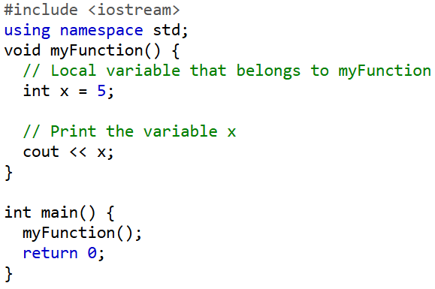

Slide 42
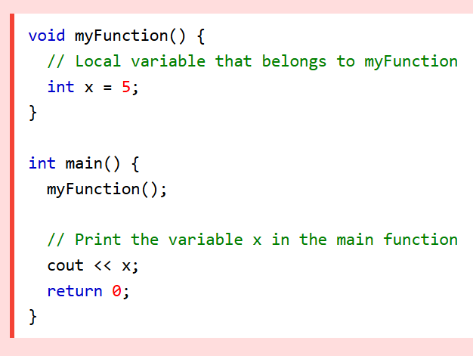
A local variable cannot be used outside the function.
If you try to access it outside the function, an error occurs

Slide 43
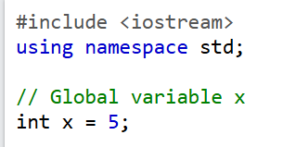
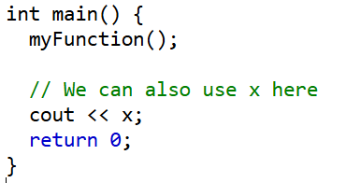
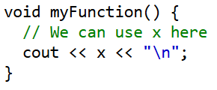
Global Variable

Slide 44
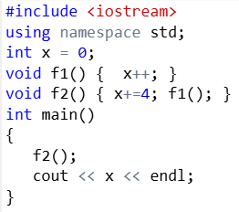
Update Global Variables
5
Notes:
#include <iostream>
using namespace std;
int x = 0;
void f1() { x++; }
void f2() { x+=4; f1(); }
int main()
{
f2();
cout << x << endl;
}

Slide 45
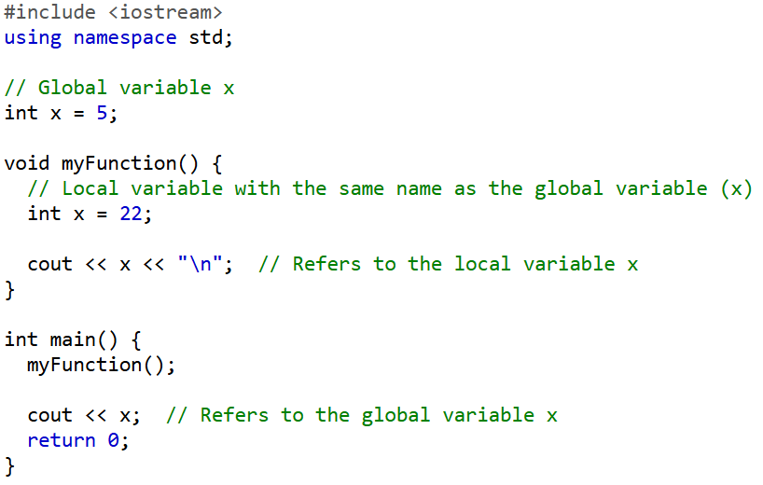
The function will print the local x, and then the code will print the global x
22
5
Notes:
22
5

Slide 46
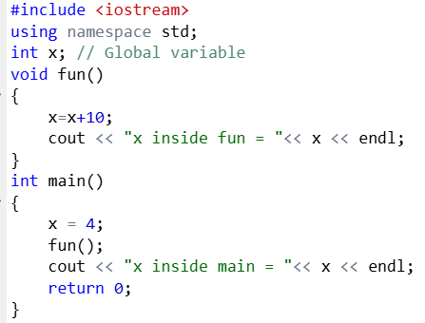
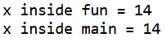
Global variables can be accessed and modified from any function.

Slide 47
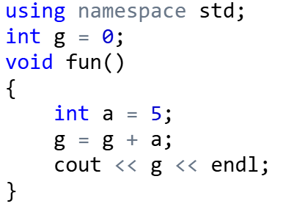
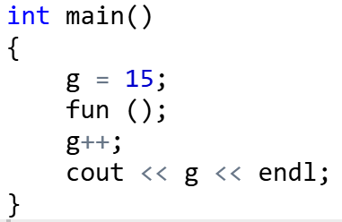
Find the output

Slide 48
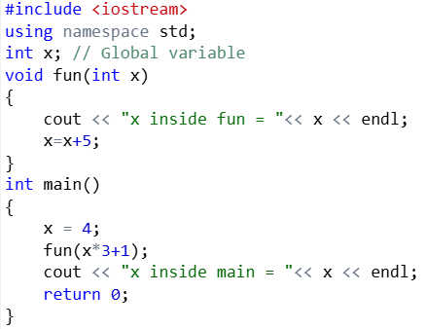
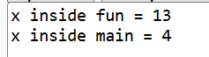
Find the output
Notes:
X inside function = 4
X global = 9

Slide 49
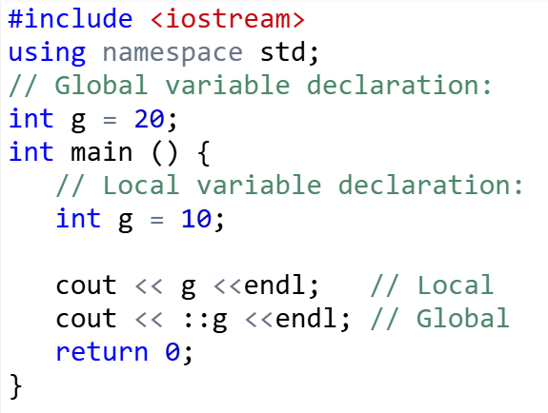
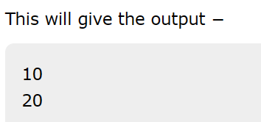
Notes:
A program can have the same name for local and global variables but the value of a local variable inside a function will take preference. For accessing the global variable with same rame, you'll have to use the scope resolution operator.

Slide 50
C++ Function Overloading
Multiple functions with the same name, but with different parameter
These functions have different parameter type
sum(int a, int b)
sum(double a, double b)
These functions have a different number of parameters
sum(int a, int b)
sum(int a, int b, int c)
These functions have a different sequence of parameters
sum(int a, double b)
sum(double a, int b)

Slide 51
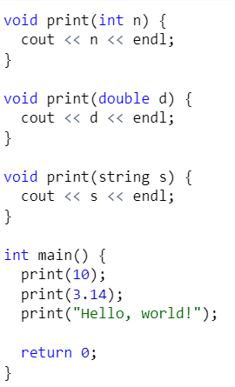
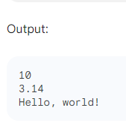
Function Overloading

Slide 52
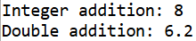
Functions have different parameter type
#include <iostream>
using namespace std;
int sum(int a, int b) {
return a + b;
}
double sum(double a, double b) {
return a + b;
}
int main() {
int x = 5, y = 3;
double a = 2.5, b = 3.7;
cout << "Integer addition: " << sum(x, y) << endl;
cout << "Double addition: " << sum(a, b) << endl;
return 0;
}

Slide 53
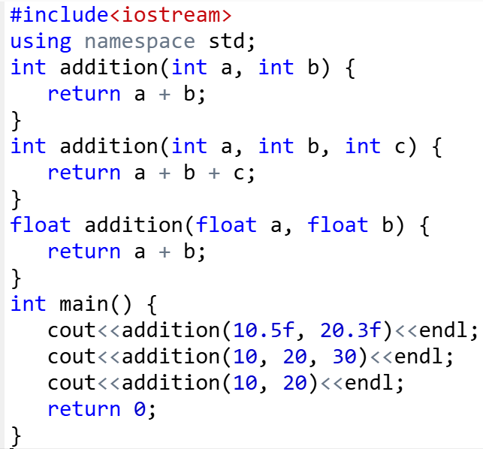

Slide 54
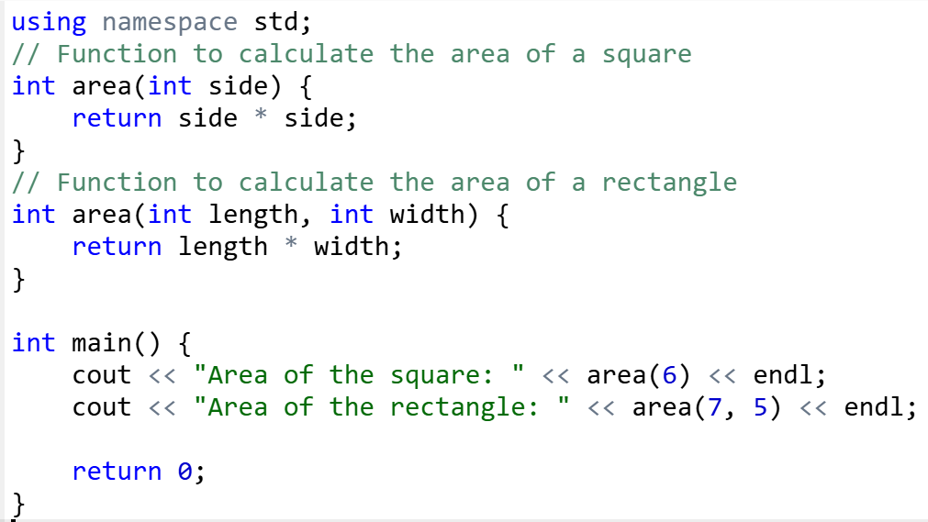

Slide 55
Default Values for Parameters
When you define a function, you can specify a default value for each of the last parameters. This value will be used if the corresponding argument is left blank when calling to the function.

Slide 56


Slide 57

#include <iostream>
using namespace std;
// defining the default arguments
void display(char c= '*', int x = 3) {
for(int i = 1; i <= x; ++i)
{
cout << c;
}
cout << endl;
}
int main() {
int count = 5;
display();
cout << "First argument passed ";
display('#');
cout << "Both arguments passed: ";
display('$', count);
return 0;
}

Slide 58


Slide 59


Notes:
#include <iostream>
using namespace std;
int sum(int b, int a=20){
return a+b;
}
int main() {
int a=100;
int b=200;
cout<< "Total value is "<<sum(a,b)<< endl;
cout<< "Total value is "<<sum(b)<< endl;
return 0;
}

Slide 60



